Slide 1
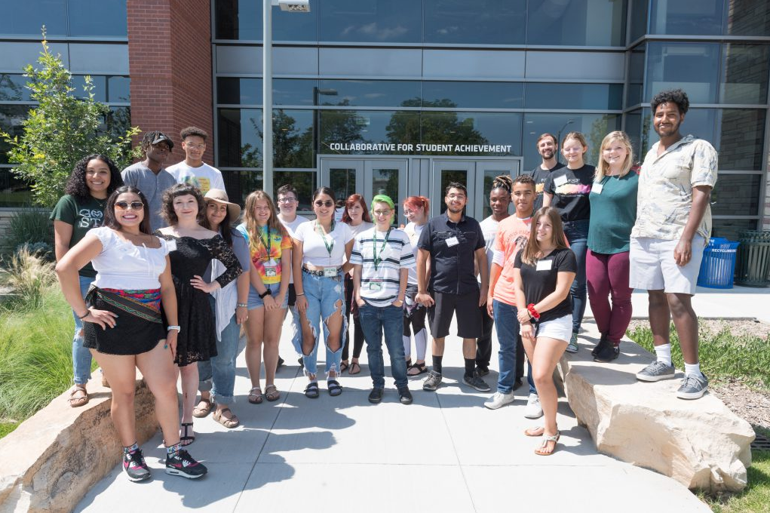
Fostering Success Program
Introductions
Name
Pronouns

Slide 2
Diversity/Equity/Inclusion

Slide 3
Diversity
“The practice or quality of including or involving people from a range of different social and ethnic backgrounds and of different genders, sexual orientations, etc.”
Gender
Sexual Orientation
Age
Disability
Income
Religious and/or spiritual beliefs

Slide 4
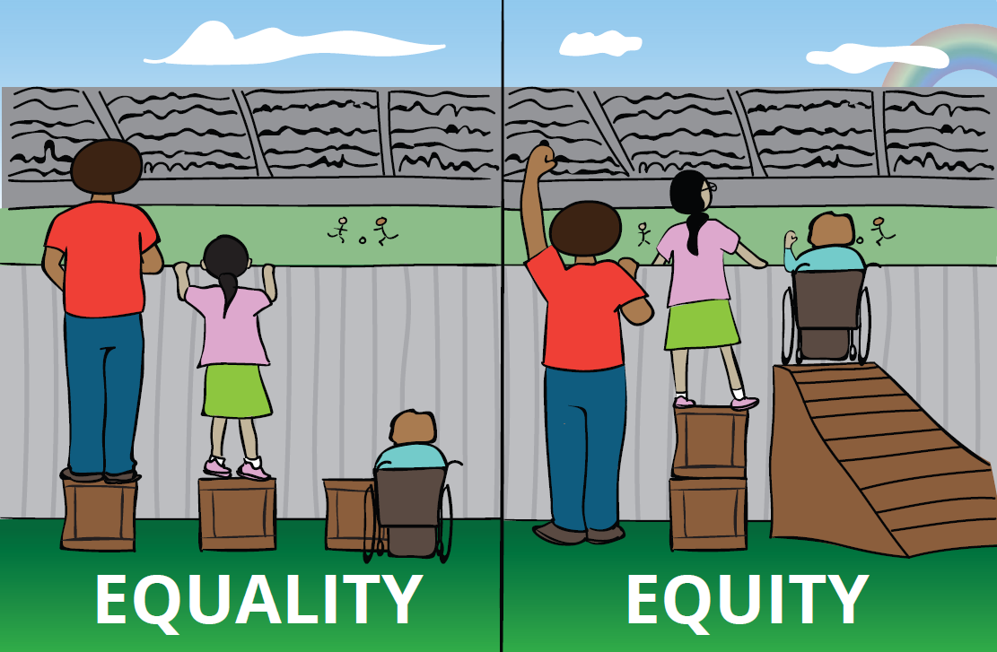
Equity
“The quality of being fair and impartial.”
Example workplace equity: Difference in salary, benefits and rewards to the employees as per their work performance, expertise and specialty.

Slide 5
Inclusion
“The action or state of including or of being included within a group or structure.”
Making people feel welcomed
Not excluding people
Respect for others

Slide 6
What Does Diversity, Equity, and Inclusion look like in FSP:
Fostering Success Program has students of all backgrounds.
The students who are in FSP are all different race and ethnicities, come from different socioeconomic classes, gender/sex, etc…
Now, because people come from variety of backgrounds, it is not ok to exclude others based their looks
FSP is very inclusive
I have always been and felt welcomed, no matter my identity, and race/ethnicity
As an employee and a student involved with FSP I have been given things others have not and vice versa (care packages) the things we ask for that benefit us.

Slide 7
What is trauma?
Trauma results from a single incident, group of incidents, or situations that overwhelm an individual’s ability to cope.
Experiencing or witnessing emotional, sexual or physical abuse
Facing chronic poverty and/or homelessness
Being physically or emotionally neglected during childhood
Being raised by someone with a behavioral health disorder, untreated and treated
Experiencing or seeing violent acts in the home, community, or in other arenas (PTSD)
Losing a loved one suddenly, unexpectedly, or violently
Surviving a natural or human-made disaster
Bullying
Intimate partner Violence
Notes:
Furness-Kraft, S. Green, P. (n.d.). An introduction to Trauma-Informed Care. [MOOC]. Relias. https://www.relias.com/topic/trauma-informed-care

Slide 8
What is Trauma?
What is Traumatic for one person is not necessarily traumatic for another. It is important to remember that what happened is not nearly important as what the trauma means to the individual.
Trauma can affect multiple aspects of someone’s life.
Behavior
Biology
Relationships
Lifelong

Slide 9
Trauma-Informed Care
Working to meet the needs of individuals that may have experienced trauma and create environments that avoid re-traumatization as much as possible.
understand individual experiences in order to deliver proper care or support.
Emphasizes individuals gain skills and adapt to traumatic events, situations and any possible diagnoses and symptoms that are related. The focus is then on individual experience and need vs their trauma.
Focus on elements of collaboration and empowerment when interacting
Our students are resilient
We provide them resources and support based on their experience and what their perception of need is
Notes:
For Professionals there usually is a level of psychoeducation, collaboration, and empowerment when working with clients but when working with our students definitely focus on the collaboration and empowerment elements. The panel covers well how you can navigate a conversation about trauma (16:15), listening and holding space for them to share what they need to. I would definelty re-watch that part of the panel if you feel like you need to because what the mentors shared was spot on.

Slide 10
Motivational Interviewing
Kori’s response to the same question, “How do you navigate conversations when a mentee share sensitive information?” touches on motivational interviewing.
You are practicing MI when you use OARS (Miller & Rollnick, 1991).
Open (rather than closed) questions:
“How do you feel about that?” (open) versus “Did that make you mad?” (closed)
Affirmations (for positive reinforcement):
“You’re doing a good job of keeping your appointments.”
“Congratulations on taking your medications regularly – that can be difficult for many people!”
Reflections (repeat, rephrase, paraphrase):
“It sounds like you are worried about your headaches.”
“Are you saying that you are afraid to ask your partner to use condoms?”
Summary (2 or 3 key points raised by the student):
“So the main things you want to do today are to fill your prescription and find out about the support group.”
“It looks like we have your new exercise plan in place and you will start with Step 1 tomorrow.”

Slide 11
Motivational Interviewing
The spirit of motivational interviewing is trying to understand someone based in their values and what is important to them.
How much is this concerning you?
What concerns you about….?
Can you think of any possible effects of this?
What are you will be outcome of this situation?
What are the good things that have come out of this?

Slide 12
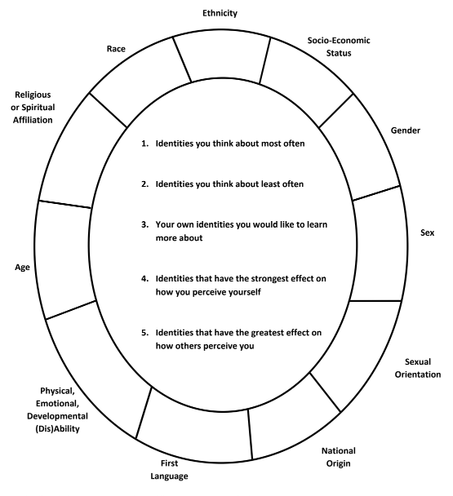
Identity Wheel Activity
Pause the video and take 10-15 minutes to complete this activity.
Draw your own identity wheel or print the provided worksheet.
For each identity, write how you identify (ie for “Sex” I identify as “Female” and for “Gender” I identify as “Woman”)
Write responses to the questions in the middle of the identity wheel
Notes:
Add private note to me in the chat if you haven’t shared your independent background with us yet

Slide 13
Reflecting on Identity Wheel
Referencing your wheel:
What are your privileged identities?
What are you marginalized identities?
Recognizing FSP students:
Likely have multiple marginalized identities
These intersecting identities create multiple forms of discrimination & oppression
Self-Reflection:
How do you present to FSP students given you may have different identities?
What are some strategies for honoring others with intersecting identities?
Notes:
Add private note to me in the chat if you haven’t shared your independent background with us yet

Slide 14
Recognizing Power Dynamics
Even if we don’t desire them to exist, power dynamics are real
Privileged identities can factor into a power differential
Awareness of body language, positioning, talk time
Understanding the transactional nature of our culture
Dismantling greater power/influence of a “helper” in comparison to the group being “helped”
Notes:
Add private note to me in the chat if you haven’t shared your independent background with us yet

Slide 15
Lessening Power Dynamics
No forced connecting: understanding FSP students are voluntarily participating
Self processing: remembering your personal motives for pursuing opportunities
Open communication: pursuing respectful dialogue when giving and receiving critical feedback
Validation: you have as much or more to learn in the relationship as the FSP student
Patience: giving FSP students and yourself space to grow
Notes:
Will hear from your mentor the first week of classes

Slide 16
References
Brookhaven National Laboratory. 2022. Computational Science Initiative: Diversity, Equity & Inclusion Council. https://www.bnl.gov/compsci/dei-council.php
Furness-Kraft, S. Green, P. (n.d.). An introduction to Trauma-Informed Care. [MOOC]. Relias. https://www.relias.com/topic/trauma-informed-care
Intergroup Relations and Spectrum Center. 2022. Social Identity Wheel. https://drive.google.com/file/d/1w7yo6ljyS0pnvEO-BOrE7Aohmaa9n5Jf/view
Notes:
Add private note to me in the chat if you haven’t shared your independent background with us yet

