Slide 1
FSP COMMUNITY
Notes:
Sergio Story. Introduce each other. Andrea, then Sergio leading to story

Slide 2
The Fostering Success Program
Vision: The Fostering Success Program builds a sense of belonging and support among independent students to foster growth and success in college and beyond.
Mission: Utilizing a solution-focused approach, we provide academic, financial, personal, and career support. By constructing a web of resource, students create an empowered and confident community working toward graduation.
Notes:
Sergio

Slide 3
Foster Youth and education
•3% of former foster youth will graduate college (Source: National Foster Youth Institute)
•Foster youth are much more likely to experience homelessness, become a victim of human trafficking and/or serve time in jail/prison than graduate college
Notes:
Andrea

Slide 4
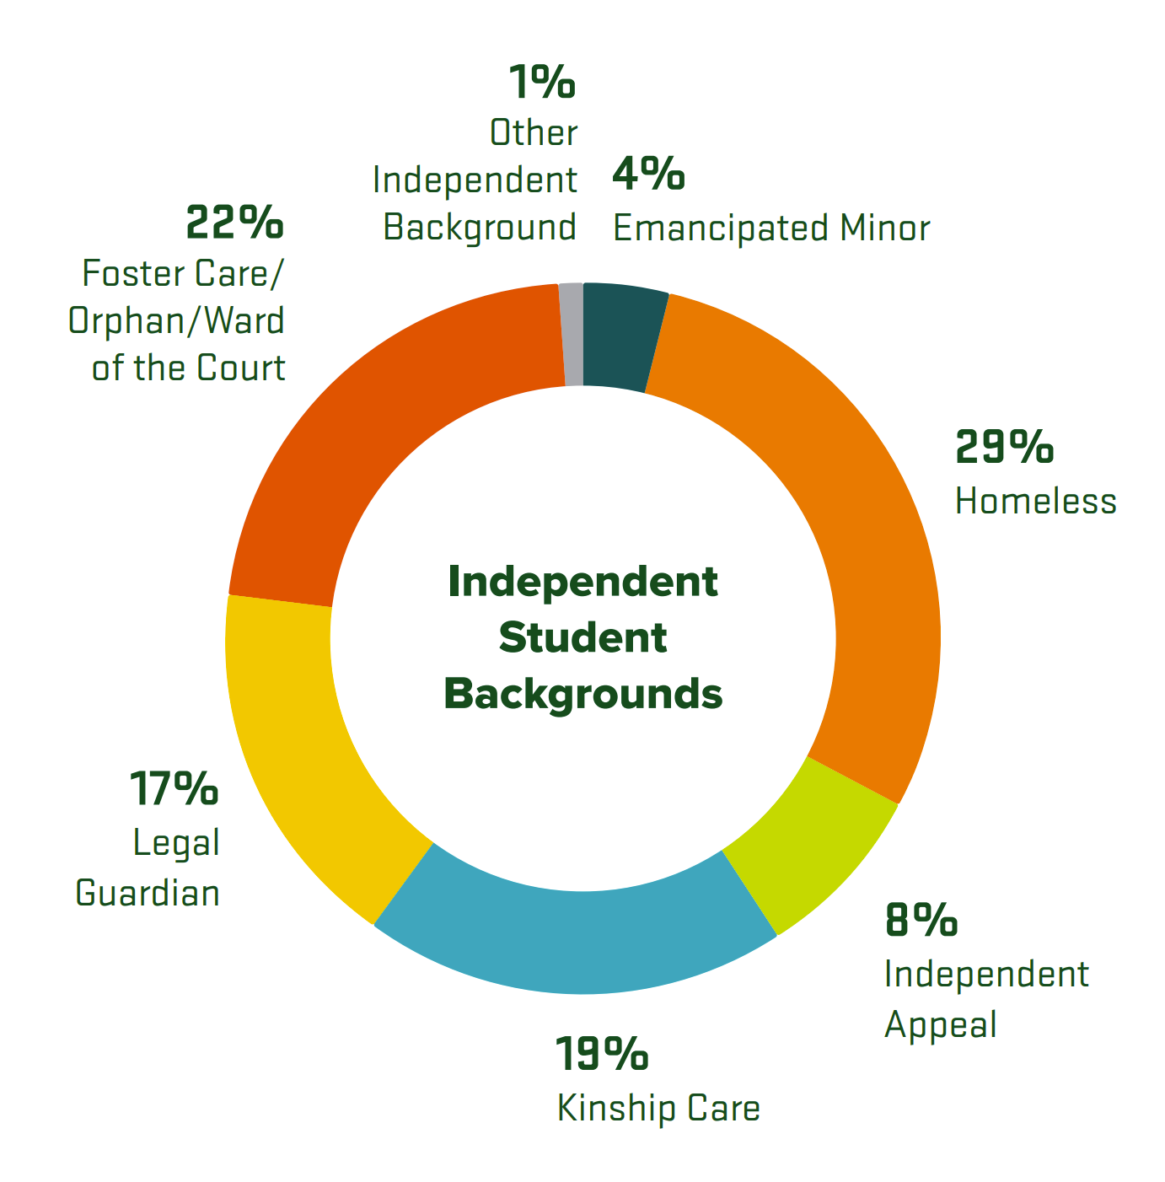
Who is eligible?
Independent students generally have had some experience with one of the following categories: foster care, ward of court, legal guardianship, kindship care, unaccompanied homeless youth, emancipation, or other types of independent backgrounds
Notes:
Andrea

Slide 5
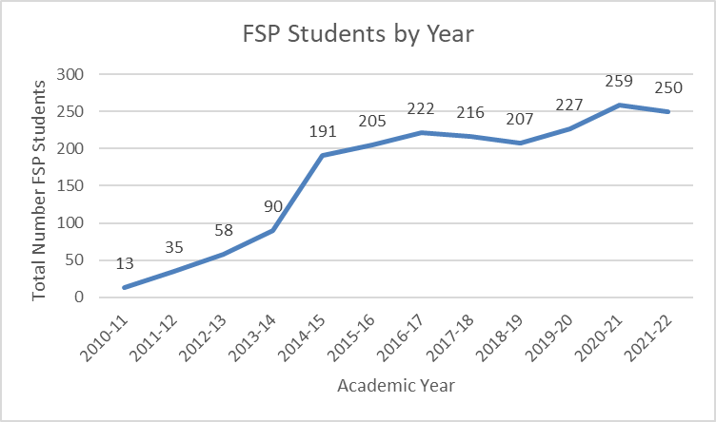
Demographics
Notes:
Andrea

Slide 6
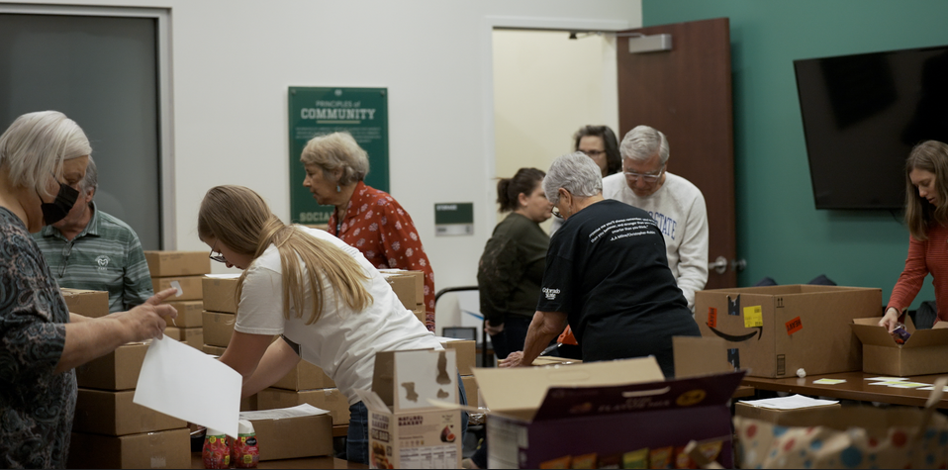
Care Packages
“I understand it’s fall break but I wanted to take a moment to thank you for the recent care package I received in behalf of FSP. I recently received said package and I was nearly brought to tears with the hand written note that came along with it. I am beyond thankful for your kind words and actions. These are the days I feel most alone and I couldn’t help but feel warm and loved so thank you for sending such kind and thoughtful gifts.”
Notes:
Andrea

Slide 7
Galena Emergency Award
Notes:
Andrea

Slide 8
Scholarships
Notes:
Sergio

Slide 9
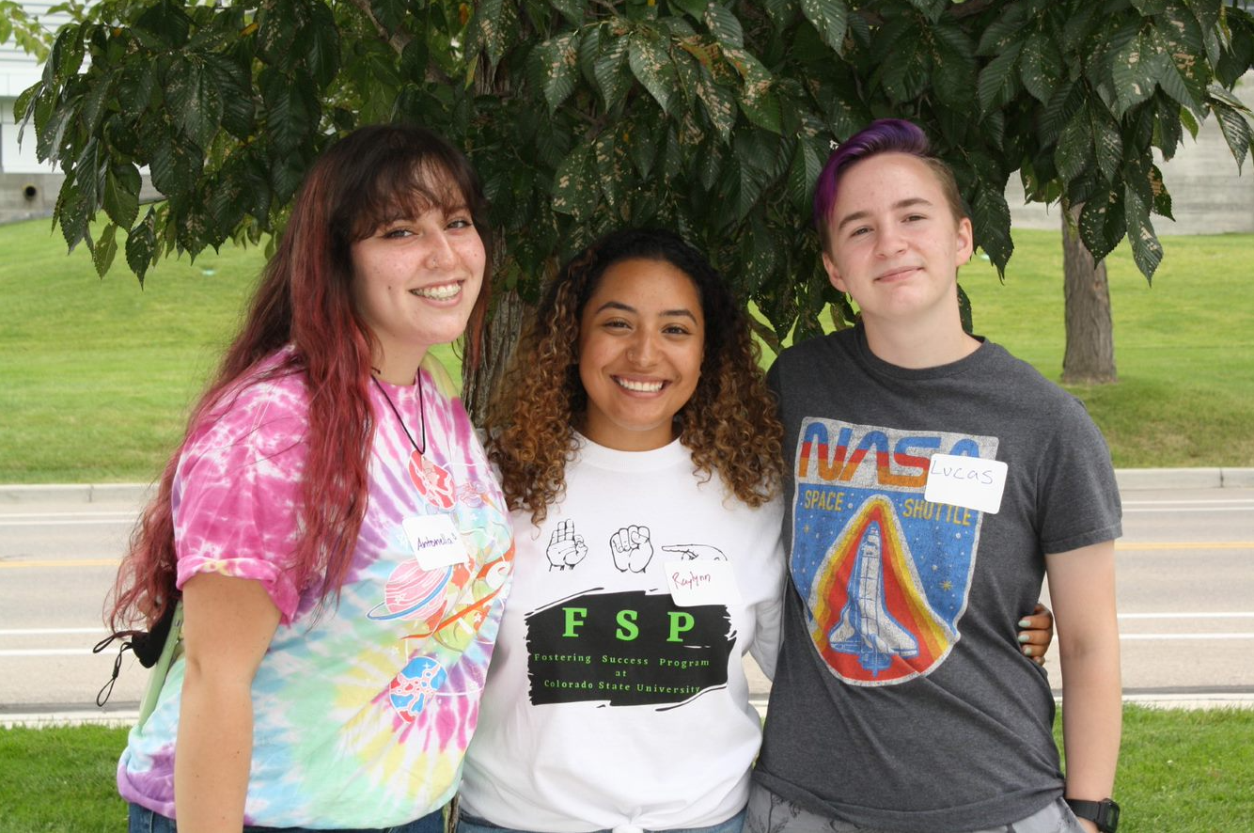
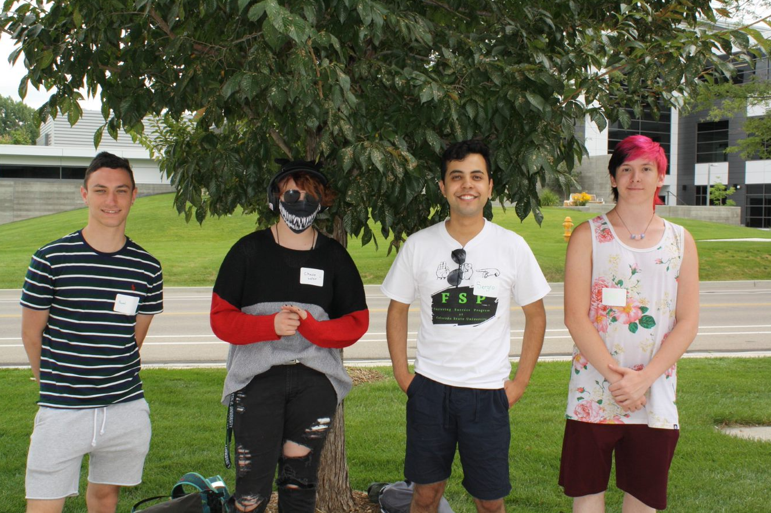
Mentoring program
"The program helped me feel more welcome and made my transition much easier. I felt less alone and always knew I had someone to confide in"
Notes:
Sergio

Slide 10
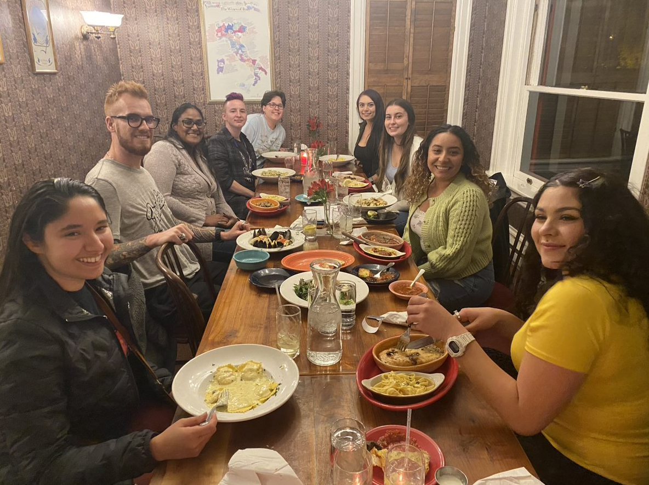
Family Dinners & Socials
"The program helped me feel like I have a community."
Notes:
Sergio

Slide 11
Who is FSP Community?
FSP Community is a network for FSP students to have connections to:
FSP alumni
CSU staff
Community supporters
Notes:
Andrea

Slide 12
How can I make a difference in FSP Community?
Positively impact FSP students through career guidance, life skills counsel and/or emotional support
Factors associated with post-college success for foster care alumni college graduates (https://static1.squarespace.com/static/59d69f1132601ec7e6e8e4da/t/6182d2b42b3c217c1e896bb4/1635963572719/Factors+Associated+with+Post-college+Success+for+Foster+Care+Alumni+College+Graduates.pdf), which concludes experiences during college in the following domains contributed to more positive post-graduation outcomes:
Supportive relationships and community connections
Life skills
Physical & mental well-being
Notes:
Andrea

Slide 13
"Networking can open doors to new opportunities that might be out of reach otherwise" (Eatough, 2021).
FSP community provides an opportunity for independent students to network with FSP alumni, CSU staff or community supporters to develop skills crucial such as networking.
Being part of FSP community gives you an opportunity to network with students via multiple ways.
Our Discord group will have an FSP Community channel.
Notes:
Sergio

Slide 14
What does FSP Community entail?
Education around independent student population
Event opportunities to mingle with FSP students
Profile featured for FSP students to view
Notes:
Andrea

Slide 15
Bibliography
National Foster Youth Initiative. 2022. Revolutionizing the American Foster Care System Through Education, Action, and Lifting Up Foster Youth Voices. February 17, 2022. https://nfyi.org/.
What is networking and why is it so important? What Is Networking and Why Is It So Important? (n.d.). Retrieved August 1, 2022, from https://www.betterup.com/blog/networking

