Slide 1
Bridge Scholars 2025
Information Session

Slide 2
What is the Bridge Scholars Program?
8-week summer residential program before your first fall semester
Participation is at no cost to the student.
$2,500 per year Partnership Award Scholarship opportunity
Jump start on academic journey - 6 CSU Credits
Build a community on campus

Slide 3
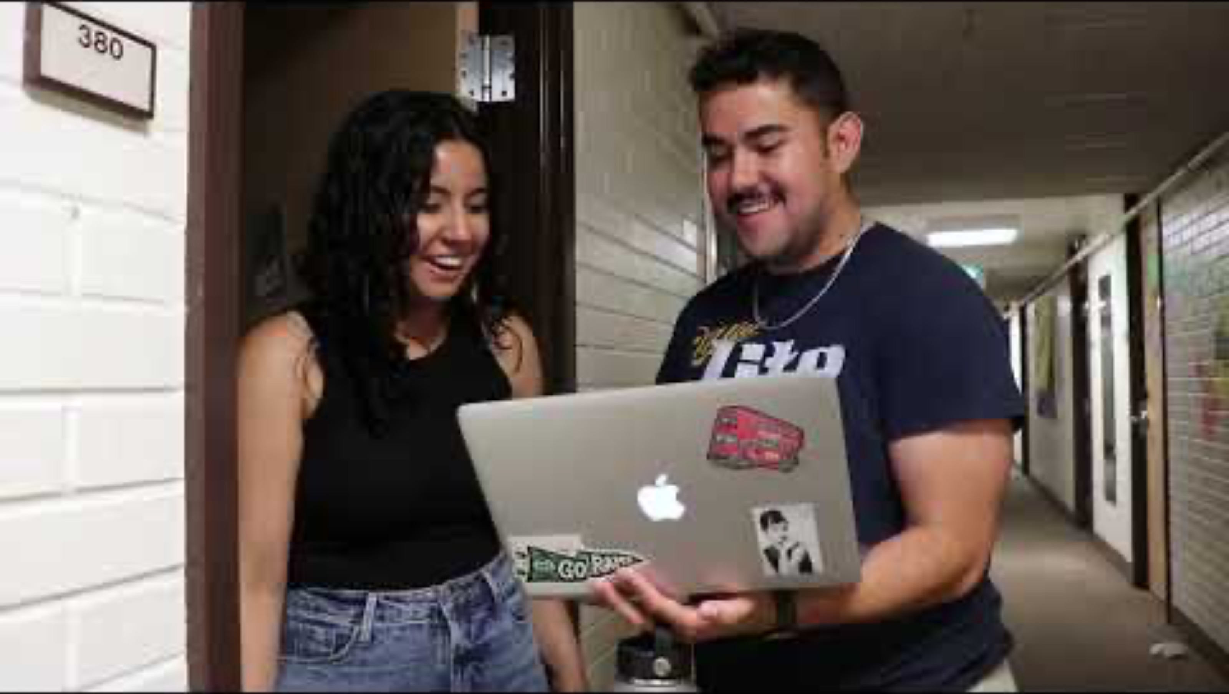

Slide 4
Requirements
Be eligible for Colorado in-state tuition
Be accepted for admission CSU as a first-year student for Fall 2025
Be committed to attending and completing degree at CSU Fort Collins
Priority will be given to those who are First-Generation and/or show financial need
Submit Financial Aid Applications

Slide 5
Application Deadlines for Summer 2025
February 3rd: Priority Review
March 3rd: Regular Review Deadline
*Application will stay open until all spots are filled
*Deadlines change year to year

